Slide 1


Detection of rust in Caturra coffee, from
data from a wireless sensor network, using
decision trees

Slide 2






Team Presentation
Miguel Ángel Martínez Flórez
Pablo Maya Villegas
Miguel Correa
Mauricio
Toro
https://github.com/pmayavi/ST0245-002/tree/master/proyecto

Slide 3
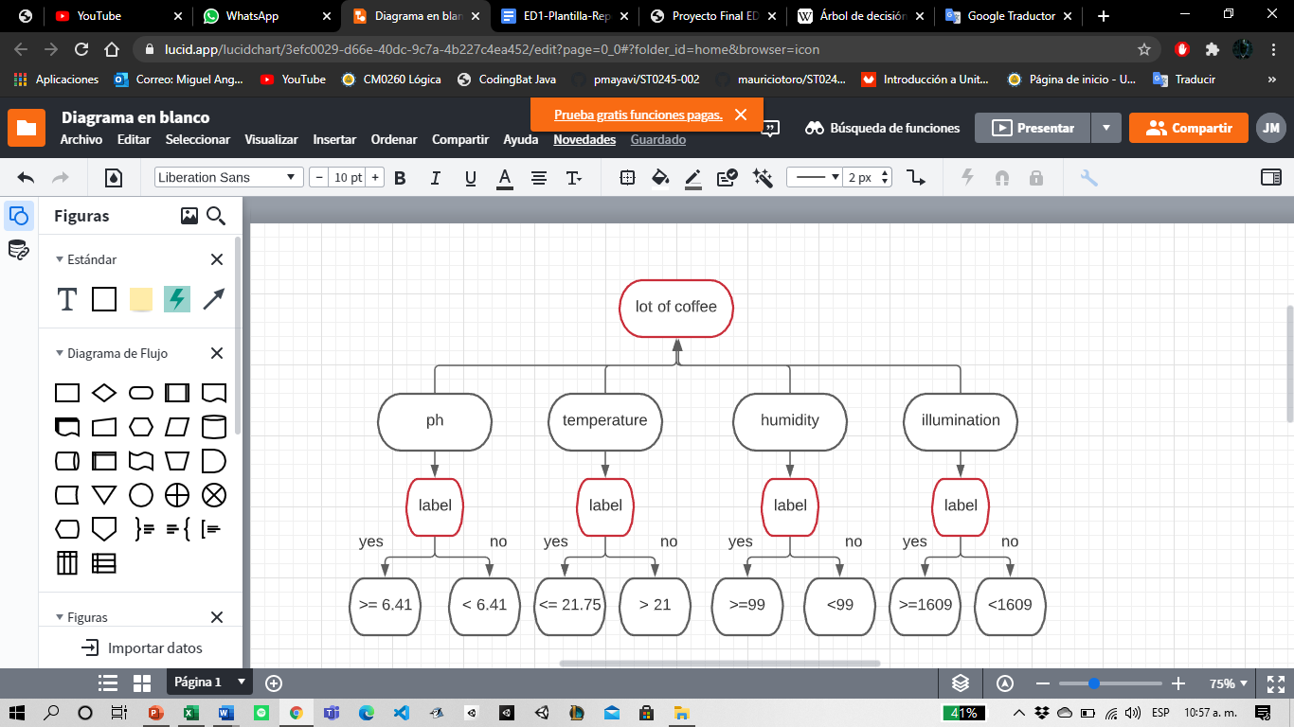
Algorithm Design
As we know, the main function of the tree is to decide if any of the variables considered that are fundamental for the root, such as temperature, humidity, etc. contain the virus in label and according to the standards of each variable it is indicated whether or not it has a label. here we use the decision tree id3 to identify that the most influential values are the soil humidity and illuminance.

Slide 4
Division of a node
soil
moisture
Gini:
0.39
Gini:
0.49
Gini:
0.39
<= 67.64 >=
Gini:
0.49
Gini:
0.49
Gini:
0.48
#: 304
Gini:
0.0
#: 68
Testing in all or some values we check in what interval the weighted gini value is the smallest
Here we can confirm that when moisture is higher than 68 then its guaranteed that the plant doesn’t have the Roya disease and we can separate the tree

Slide 5
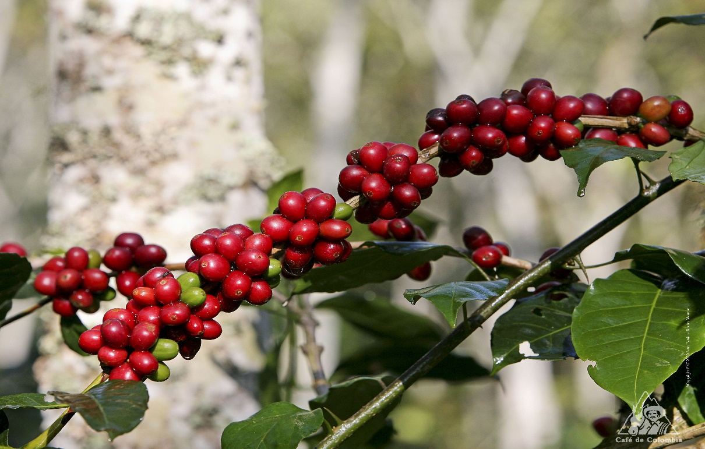
Complexity of the Algorithm
 | Time complexity | Memory complexity
Train the decision tree | O(N*M) | O(N*M)
Validate the decision tree | O(N) | O(1)
Reader.reader() | O(N)
Trainer.main() | O(N*M)
Trainer.trainer() | O(N*M)
Tree.main() | O(N)
Tree.tree() | O(N)
The time and memory complexity of our algorithm is performed with CART. The n and m terms are representations of the complexity of the algorithm.
. N is the amount of data in the file.
. M is the number of times the cycle of searching for the best division number is repeated.

Slide 6


Decision Tree Model
372 48% have Roya Is it > 68 soil moisture?
307 59% have Roya Is it > 48 soil moisture?
65 0% have Roya
169 71% have Roya
138 44% have Roya
Is it > 2700 illuminance?
52 26% have Roya
86 54% have Roya
Relevant characteristics:
Soil moisture
Illuminance
The CART decision tree, it tries multiple values and selects the one that leaves the purest node possible, then it divides the impure one

Slide 7
Evaluation Metrics
Accuracy, the percentage of values classified accordingly
Recall, the percentage of values classified correctly from the whole data
Precision, the percentage of values classified correctly in the field
60% recall
80% accuracy
66% precision

Slide 8
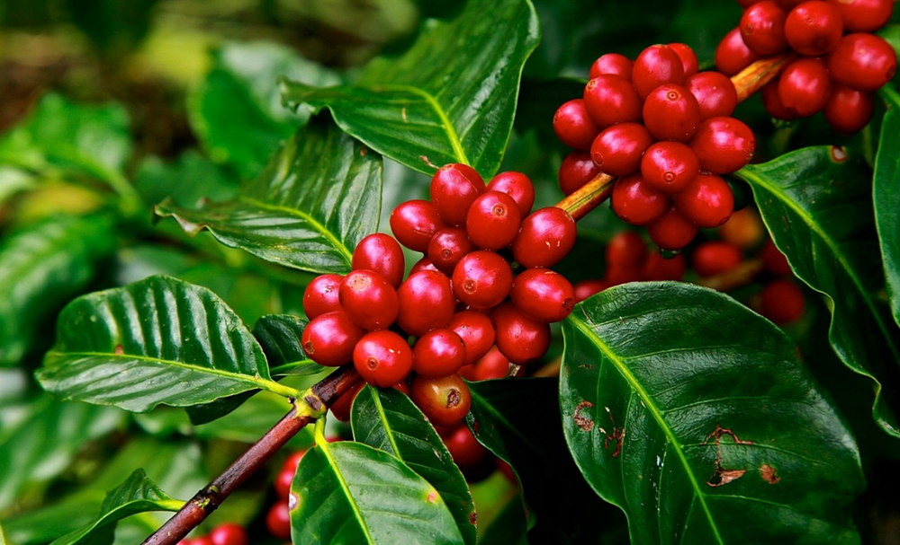
Evaluation Metrics
 | Data set 1 | Data set 2 | Data set 3
Accuracy | 85% | 81% | 62%
Precision | 90% | 66% | 52%
Recall | 96% | 80% | 84%
Evaluation metrics obtained with the training data sets of size 300, 600 and 900

Slide 9


Time and memory consumption
Time consumption
Memory consumption

Slide 10
THANK YOU FOR LISTENING TO US!

